Slide 1


Presented by:
Valentin Arroyo
Asel Kahveci
Max Le
Matthew Li
Itzamna Mendoza
Krrishil Raval
Paul Zieba
Rating: Sell/Hold
Celanese Corporation (CE)

Slide 2

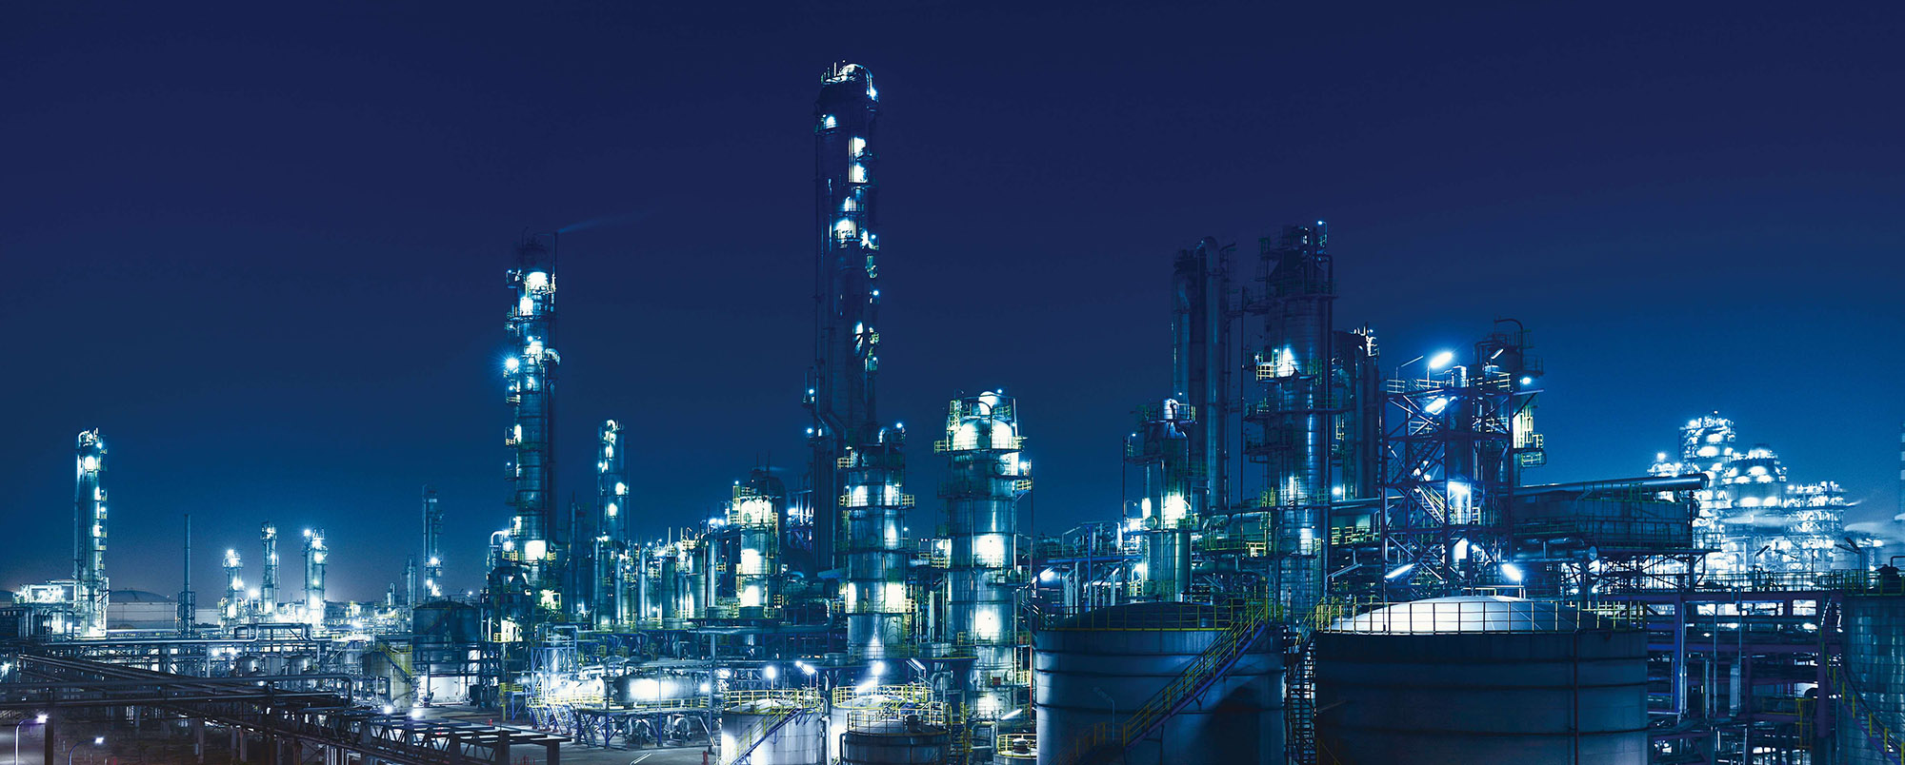
Table of Contents
Investment Thesis
Company Overview
Operations breakdown
Geographic Overview
Industry Standing
Historical Analysis
S.W.O.T Analysis
Risk Factors
Company Vs Competitors
Financial Slides
Conclusion

Slide 3
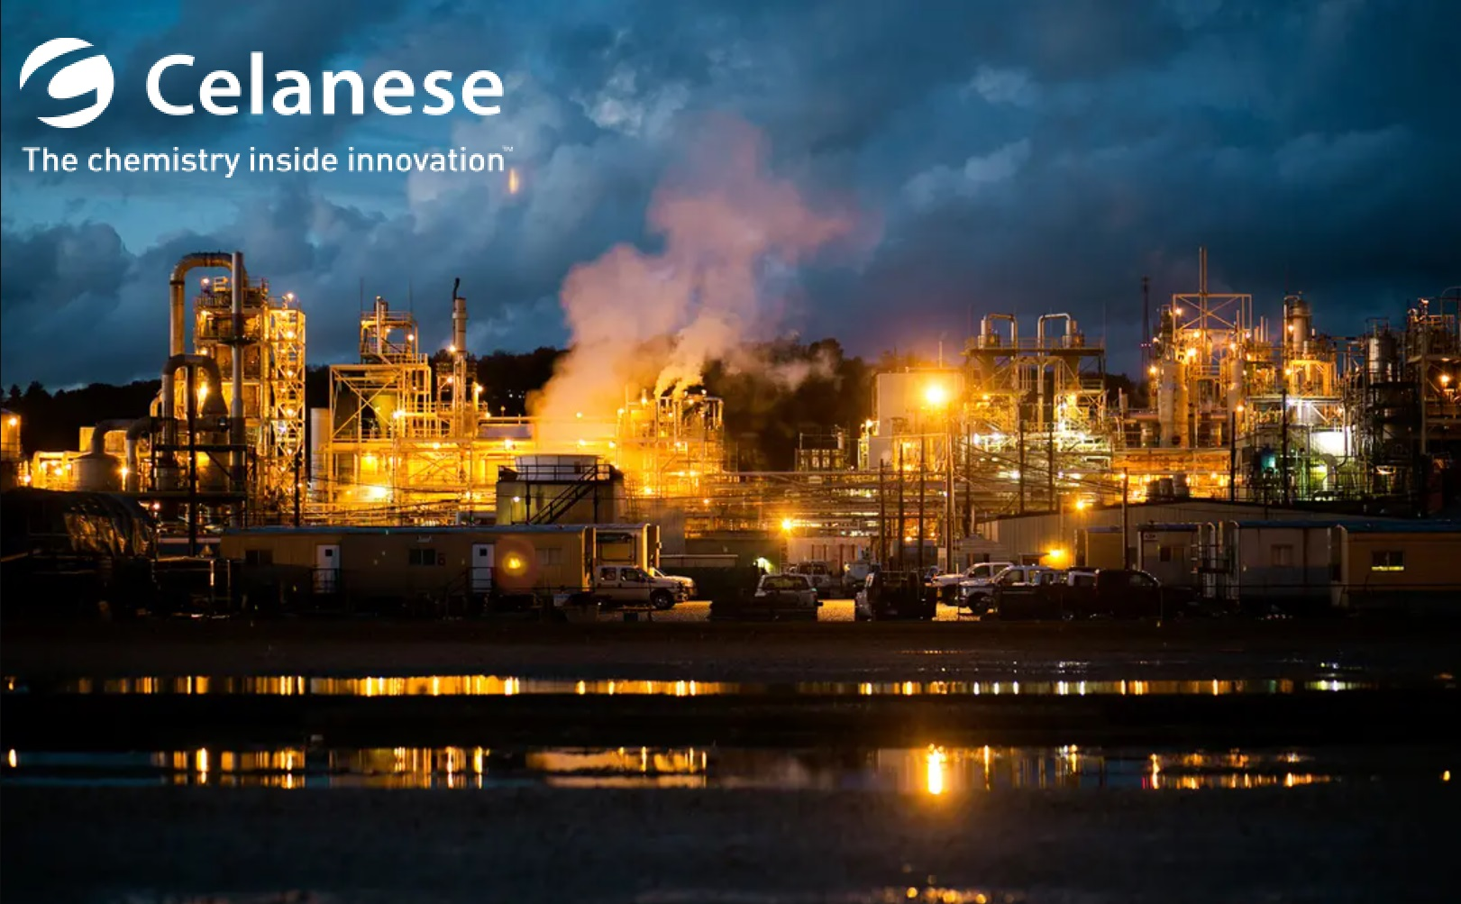
Investment Thesis
Substantially increased its leverage by
Future growth prospect
Interest payments accounting for 70% of EBIT
DOL
Macro-economic and geopolitical uncertainty on revenue streams
The China issue
Underperformed the S&P 500
EPS and future industry growth projections
Fundamentally flawed business model
More of a producer than a marketplace "Amazon"
Company's view on individual products (UHMW-PE)
Notes:
Future growth prospects relates to a potential reliance on acquisitions for pure growth which is a bit worrisome given their low ROIC and ROCE figures.
Interest payment make up a large portion of their income (70%) which could have been reinvested also which is being offset by tax deferrals.
PMT investment Methodology: Hold as long as possible but in this case a lot of the bad things start to come to fruition in the longer time horizon.
CE has an above average DOL mean they're bottom lines are highly impacted by revenue fluctuations,
High degree of macro economic uncertainty as seen with the Chinese real estate collapse which directly impacts construction and future development, but at the same time their was an unprecedented $284B stimulus injections into the economy. (Consumer confidence is at an all time low)
Celanese's eps and industry growth projects seem to correlate but plateau a few years out
CEO is quoted saying they're trying to be like what amazon is for ecommerce.
Why produce subpar polymers (UHMW-PE) when you have the raw material to produce polyolefin Film and Microporous PP the industry standard.

Slide 4

Company Overview
Founded in 1918 by Camille Dreyfus in New York
HQ: Irving, Texas, U.S.
Current CEO: Lori J. Ryerkerk
Originally, known as AmCell, produced fabrics for airplanes. Main market was a silk alternative.
Eventually branching off into Chemical production, Advanced Engineering Materials, Cellulose base consumer goods, and Alternative Energy production.
Issued an IPO on Jan 21, 2005
Industry leader within acetic acid, with 25% global market share.
Notes:
Eliezer

Slide 5
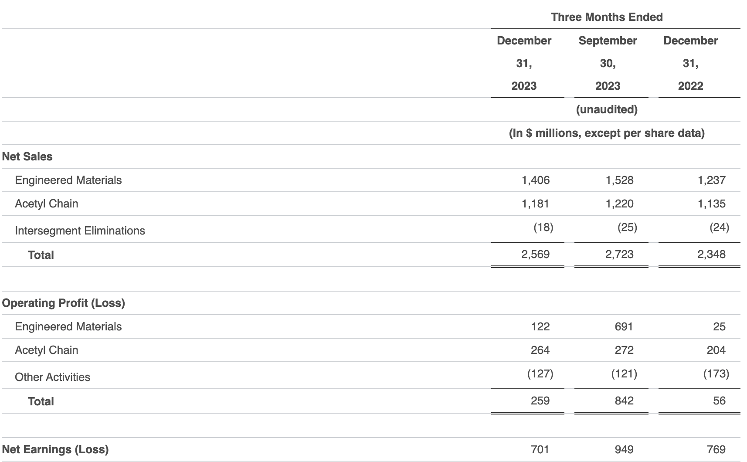
Operations Breakdown
Acetyl Chain
Net Sales of $4.9 billion in 2023, 15% decrease from prior year
Net Sales reflected a 17% decrease in pricing, resulting in $1 billion headwind
Weak demand across many end markets
Despite challenges, delivered second highest ever earnings (operating profit of $264 million, adjusted EBIT of $300 million)
Sourcing volume from third parties
Engineered Materials (56% of Total Revenue)
Net Sales of $6.1 billion in 2023, 53% increase from prior year due to M&M acquisition in Q4 2022
Volume decreased by 8% and pricing decreased by 3% from prior year
Responded by accelerating M&M synergy actions
Notes:
Eliezer

Slide 6
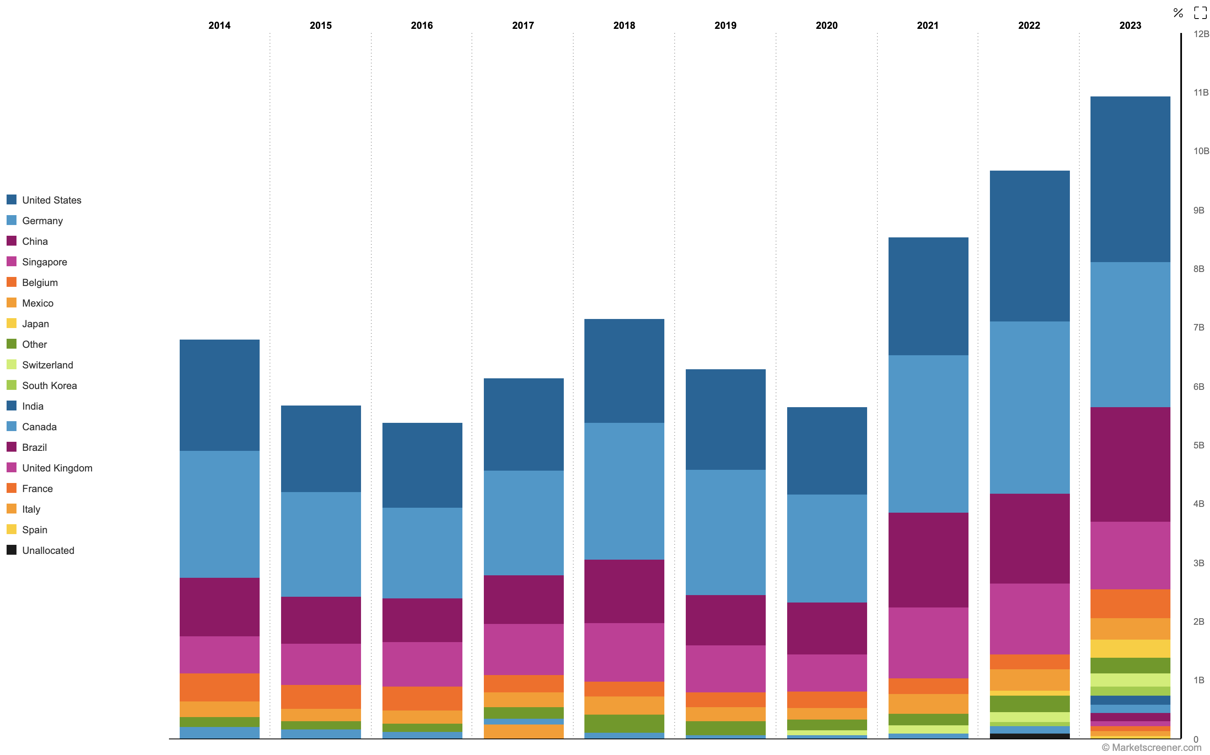
Geographic Overview
26% of revenue comes from the US, with 2.82B
22.56% of revenue comes from Germany, with 2.47B
17.84% of revenue comes from China, with 1.95B
Rest is divided between Singapore, Belgium, Mexico, Japan, etc.
Notes:
Eliezer

Slide 7
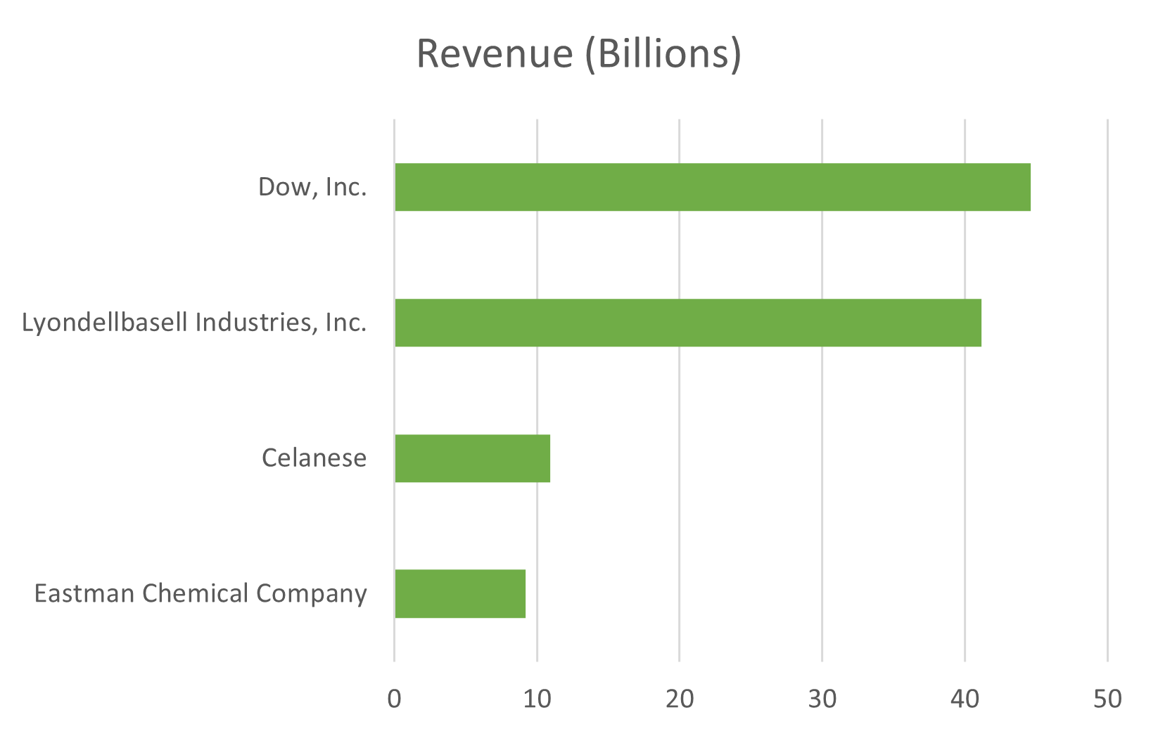
Industry Standing-Competitors
Within Industry Competitors Celanese on the lower end of revenue.
Celanese not nearly as large as Dow, Inc and LI, Inc barely beats out ECC.
Notes:
Eliezer

Slide 8
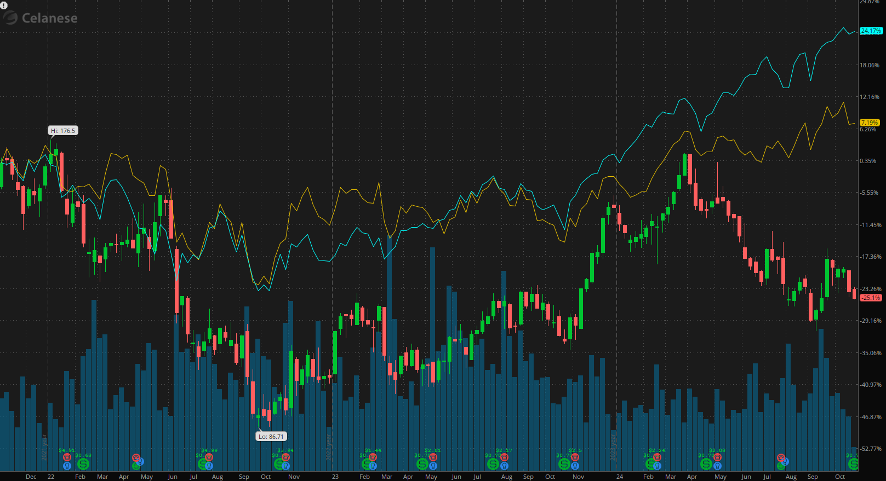
Historical Analysis
3 Year % change
S&P 500: 24.17%
XLB: 7.19%
CE: -25.1%
Missed 2024 Q2 earnings
Appointed Mr. Ganesh Moorthy to its Board of Directors
Acquired DuPont's Mobility & Materials (M&M) segment during late 2022 for $11 billion in cash
Notes:
2017 up 75%
2019 – Current: Around 20% increase yearly

Slide 9
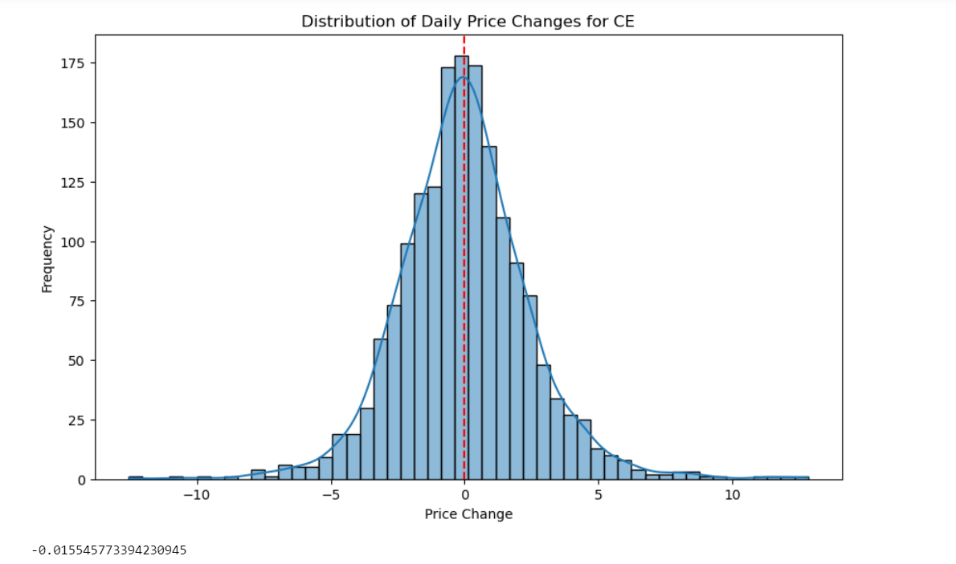
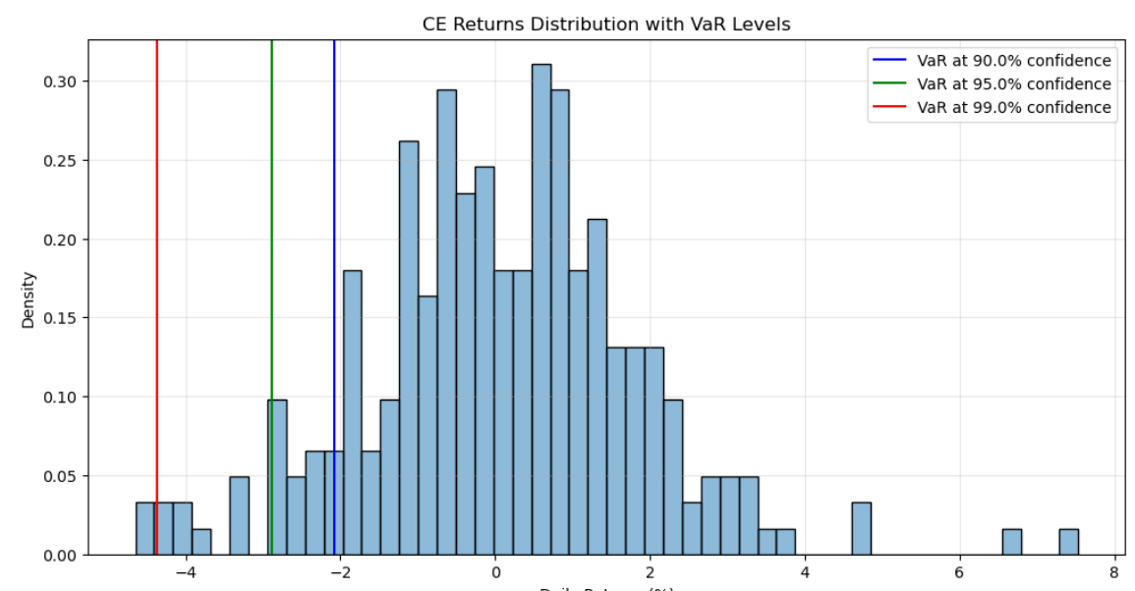
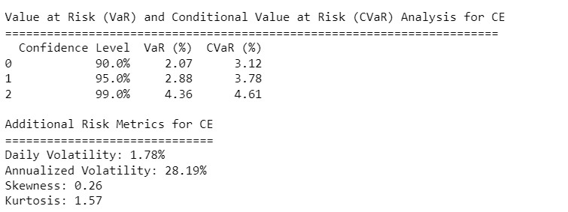
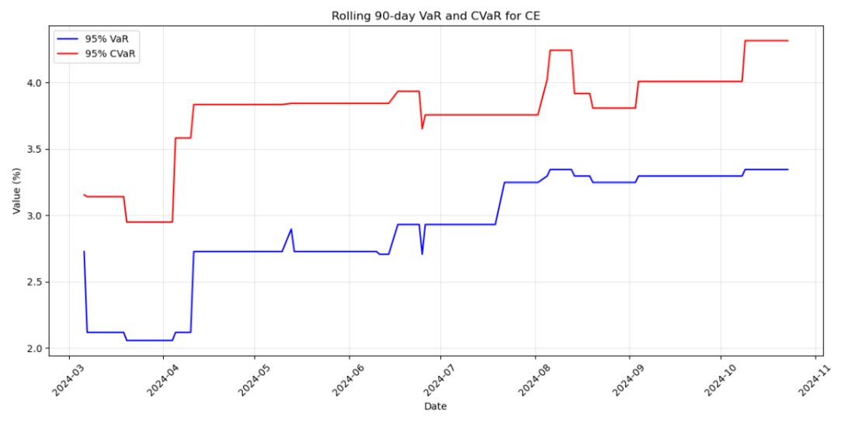
Notes:
2017 up 75%
2019 – Current: Around 20% increase yearly

Slide 10
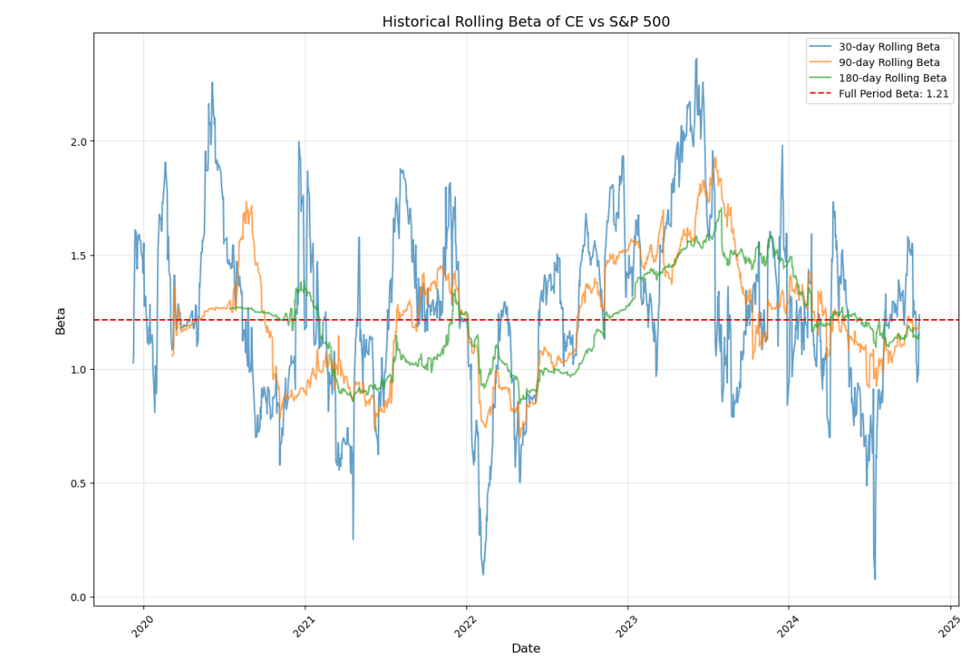
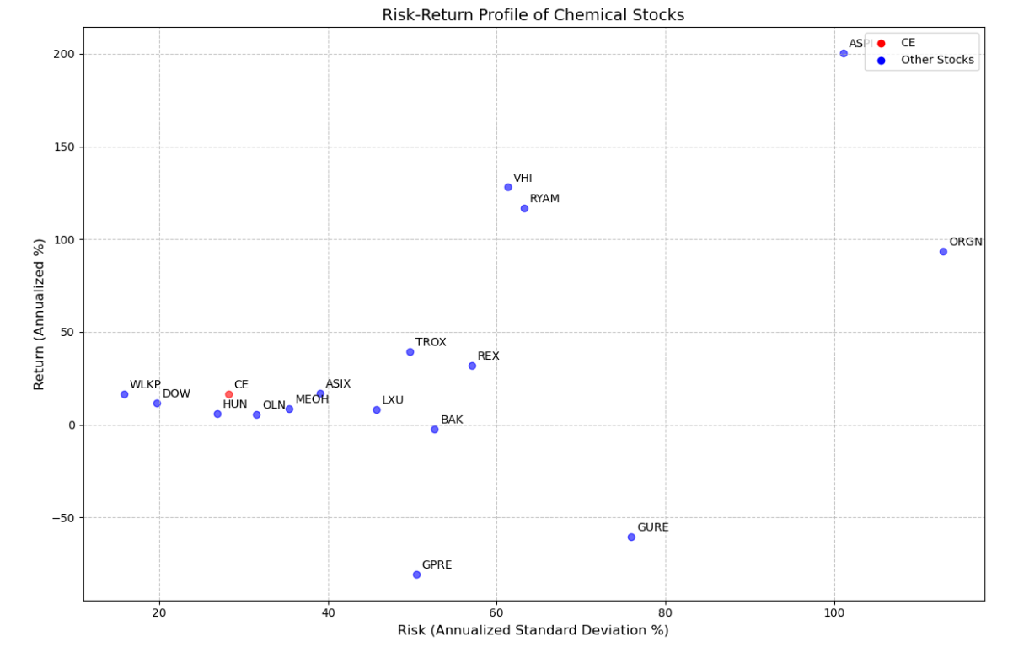
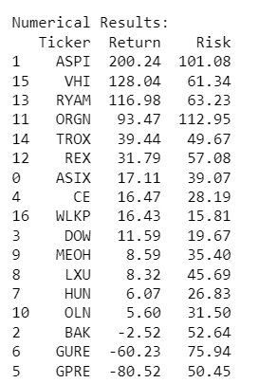
Notes:
2017 up 75%
2019 – Current: Around 20% increase yearly

Slide 11
S.W.O.T Analysis
Strengths
Diverse portfolio
Global Presence
Weaknesses
High interest expenses
Regulation changes
Opportunities
Market expansion
Sustainability trends
Threats
Rate Changes
Intense competition
Notes:
Jared

Slide 12
Risk Factors
Risk | Level
Risks relating to operation in international markets | High
Risks related to economic factors | Medium
Risks related to suppliers and vendors | Low
Notes:
Al
Breakdown of Risk Levels:
1. Industry & Global Economy:
- Risk Level: High
- Explanation: Caterpillar is highly affected by global economic conditions, which can cause demand for its equipment to vary with changes in commodity prices, infrastructure spending, and overall economic growth.
2. Regulatory & Legal Development:
- Risk Level: Medium
- Explanation: Changes in regulations and laws can impact Caterpillar's operations and costs. While compliance can increase costs, the company has the means to adapt over time.
3. Operations:
- Risk Level: Medium
- Explanation: Operational risks like supply chain disruptions, cybersecurity threats, and climate change impacts are significant but manageable with proper risk management. Caterpillar is taking steps to assess and mitigate these risks.

Slide 13

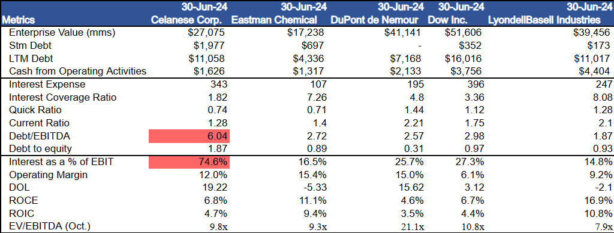
Comparables Table

Slide 14
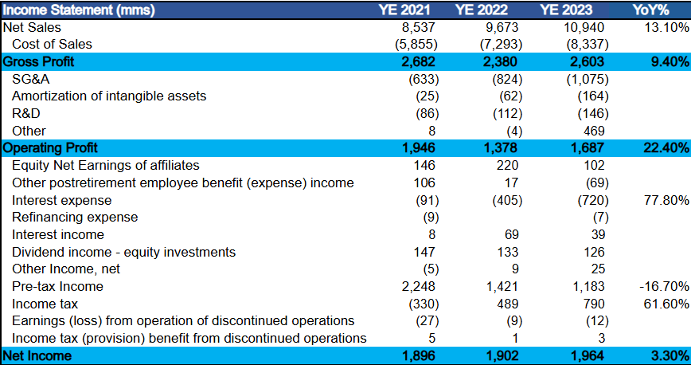
Income Statement
Income Statement:
Net Sales increase YoY from 2021 to 2023
Gross Profit Margin, 2021 (31.4%), 2022 (24.6%), 2023 (23.8%)
Gross Profit increase YoY, 2022 was set back by a decrease in volume and increases in pricing
From 2021 to 2023 there has been greatly increased capital spent on R&D.
Net Income Increased YoY from 2021 to 2023
Notes:
Valentin

Slide 15
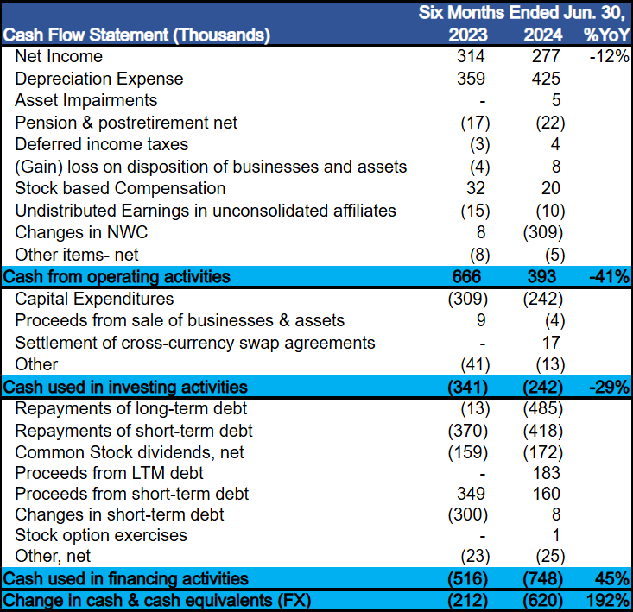
Cash Flow Analysis
Q2 2024 vs. Q2 2023
Net income in 2024 was down 12% YoY as a result of weakening domestic demand
NWC was negative in 2024 because of a $143M surplus in unsold inventory
$67M decrease in Captial Expenditures with higher amounts being spent on D&A in comparison
Greater repayments of debt in comparison to proceeds showcasing potential deleveraging
Notes:
Valentin

Slide 16
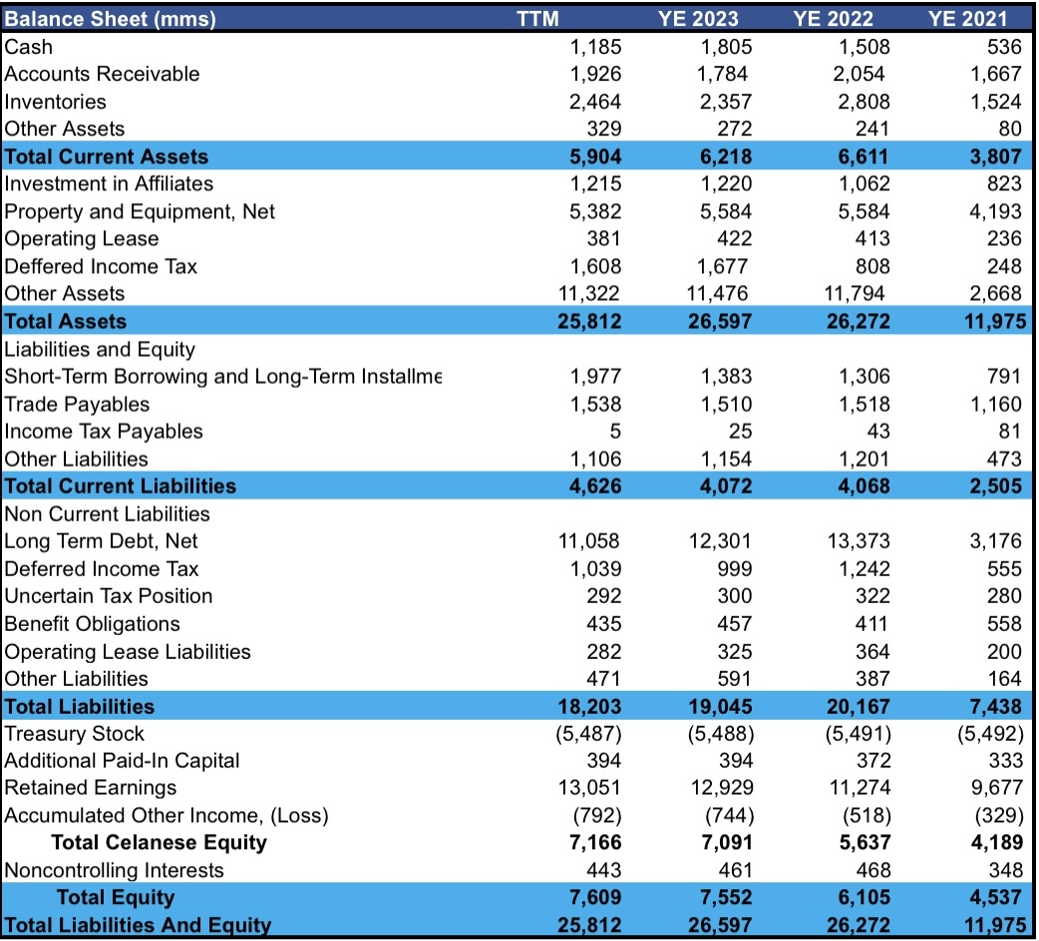
Balance Sheet
Total Assets are up by 1.23% driven by an increase of 19.69% in Cash and Cash Equivalents
Total Liabilities has decreased by 5.56%, however there has been a 171.1% increase since 2021.
Current Ratio: 1.27 x indicates that the company has enough to cover short term liabilities.
Return on Assets: 7.34% shows strong performance
Debt-to-equity Ratio: 2.39 x indicating high usage of debt.
Notes:
Valentin

Slide 17
Conclusion
Pro's
Company experienced tremendous benefit through the Dupont M&M engineered materials acquisition
Currently operating with steady YoY Free-cash-flow and Net Income
High ESG performance within the Specialty Chemicals industry
Con's
Diminishing tax deferral cushion and abnormally high interest payments in relation to debt
Consistently underperforms the S&P 500
Macro & Geopolitical uncertainty
Notes:
Strong brand; beats out literally Komatsu in their own market
Revenues returned to precovid levels; except the company is more financially lean.

Slide 18
Questions?
Notes:
Strong brand; beats out literally Komatsu in their own market
Revenues returned to precovid levels; except the company is more financially lean.

Slide 19
Appendix
Notes:
Strong brand; beats out literally Komatsu in their own market
Revenues returned to precovid levels; except the company is more financially lean.

Slide 20
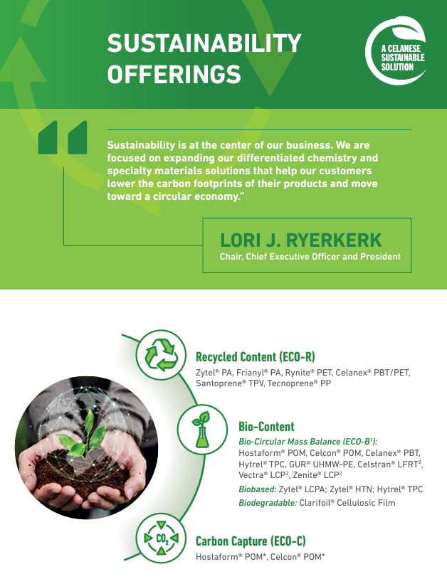
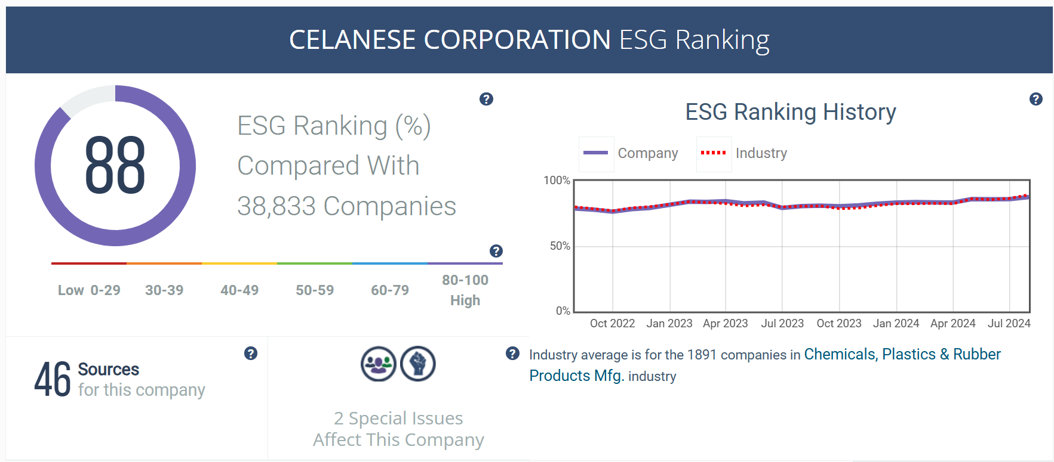
ESG Review
How is Celanese doing within the ESG space?
Notes:
Valentin

Slide 21
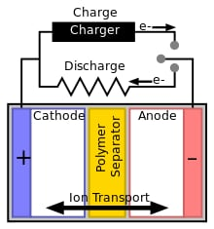

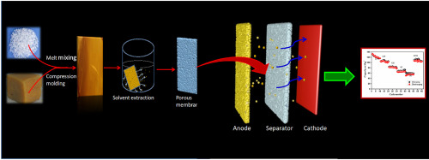
Ultra-high-molecular-weight polyethylene
https://doi.org/10.1016/j.matchemphys.2020.123473
Notes:
Valentin

